Slide 1
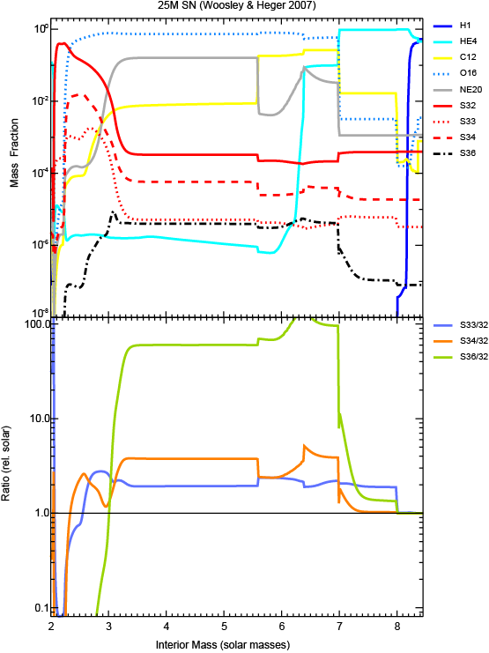
H envelope (mostly solar abundances) goes from M~8-25
³²⁻³⁴S mostly made M<3.
32 made slightly deeper than 34<33
³⁶S made M~3.5-7
I see 2 places where ³³S anomaly > ³⁴S anomaly (Arrows) and thus could get positive Δ³³Si
(does not strike me as likely since so much more of the ejecta comes out with 34>33)
36S excess is much larger than others and includes region of star (O/C and O/Ne layers) where 54Cr is formed (see Qin et al, GCA Jan 2011)
54Cr anomalies in bulk meteorites may be due to material from this zone.

Slide 2
